Slide 1
Homework Assignment #2: Solving Producer-Consumer Problem by Semaphore

Slide 2
Outline
Producer-consumer problem
Semaphore
Application Programming Interface
Pthread API
semaphore
Homework Assignment #2
Reference

Slide 3


Producer-Consumer Problem (1/2)
There are two process/threads with a fixed-sized buffer.
Producer generates data and consumer consumes the data.
Problem: how to prevent producer generate data over the buffer size or consumer remove data when the buffer is empty?
waiting
producer
block
ERROR
ERROR
consumer
3
Notes:
3

Slide 4
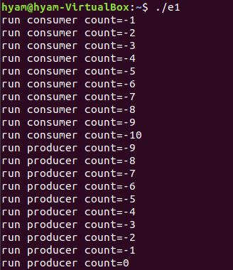
Producer-Consumer Problem (2/2)
We can see the consumer remove data when the buffer is empty.
4

Slide 5
Outline
Producer-consumer problem
Semaphore
Application Programming Interface
Pthread API
semaphore
Homework Assignment #2
Reference

Slide 6
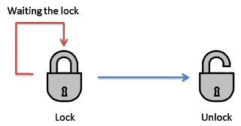
Semaphore
Sol.: we can use semaphore to record how many buffer is empty and how many buffer is full to prevent race condition.
Semaphore: can be initialized as zero or a positive integer.
When it decreases to less than zero, it while lock the process until it become zero.
Increase to
positive
Decrease the
semaphore
negative
process
process
Lock
Unlock
6

Slide 7
Semaphore
A blocking implementation of semaphores.
typedef struct {
int value;
struct thread *L;
}semaphore;
void wait(semaphore S) {
S.value--;
if(S.value < 0) {
add this thread to S.L;
block();
}
}
void signal(semaphore S) {
S.value++;
if(S.value <= 0) {
remove a thread P from S.L;
wakeup(P);
}
}
7

Slide 8
Semaphore
Mutual-Exclusion Implementation with Semaphores
void wait(semaphore S) {
S.value--;
if(S.value < 0) {
add this thread to S.L;
block();
}
}
value: 0 to -1
value: 1 to 0
value: -1 to -2
成立
不成立
成立
Process blocked
Process blocked
Process A
Process B
Process C
wait(mutex);
//critical section
signal(mutex)
wait(mutex);
//critical section
signal(mutex)
wait(mutex);
//critical section
signal(mutex)
進入CS
8

Slide 9
Semaphore
Mutual-Exclusion Implementation with Semaphores
void signal(semaphore S) {
S.value++;
if(S.value <= 0) {
remove a thread P from S.L;
wakeup(P);
}
}
value: 0 to 1
value: -2 to -1
value: -1 to 0
不成立
成立
成立
Save a process
(ex, process C)
Save a process
(ex, process B)
Process A
Process B
Process C
wait(mutex);
//critical section
signal(mutex)
wait(mutex);
//critical section
signal(mutex)
wait(mutex);
//critical section
signal(mutex)
離開CS
9

Slide 10
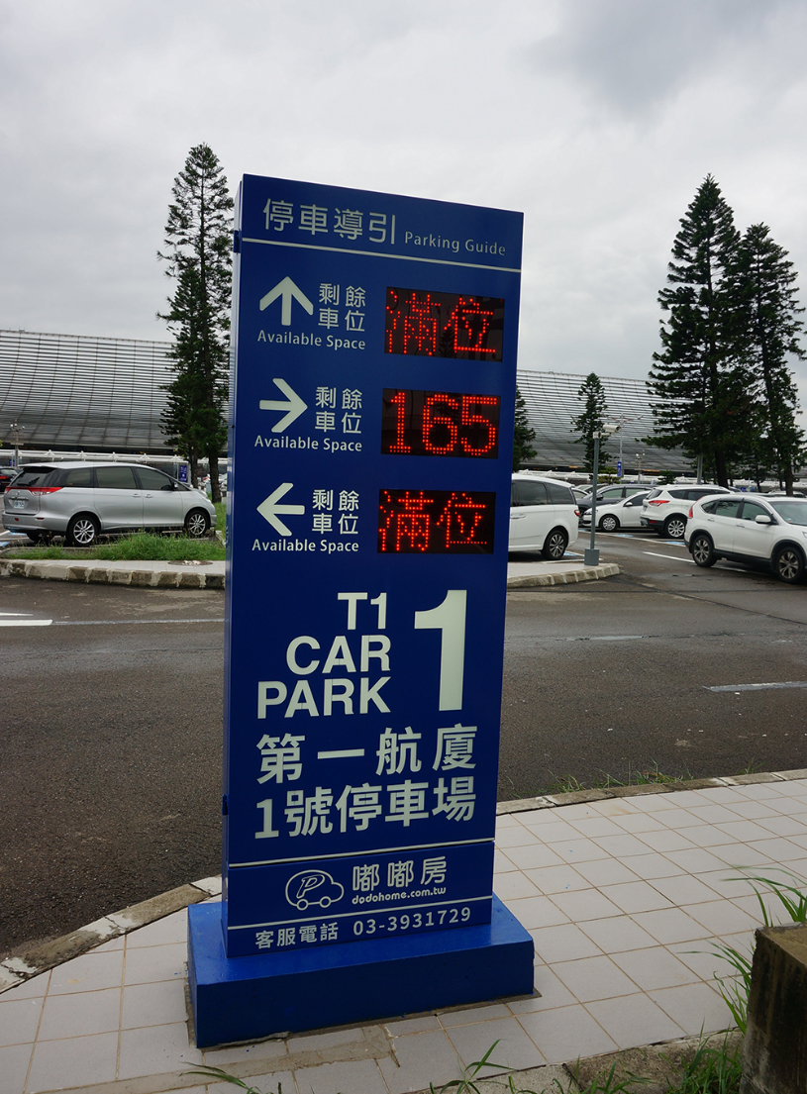
Example
A semaphore is similar to the parking guide. When a car comes in the space, it’s value is decreased. Besides, it shows the available space we can park.
10

Slide 11
Outline
Producer-consumer problem
Semaphore
Application Programming Interface
Pthread API
Semaphore
Homework Assignment #2
Reference

Slide 12
Outline
Producer-consumer problem
Semaphore
Application Programming Interface
Pthread API
Semaphore
Homework Assignment #2
Reference

Slide 13
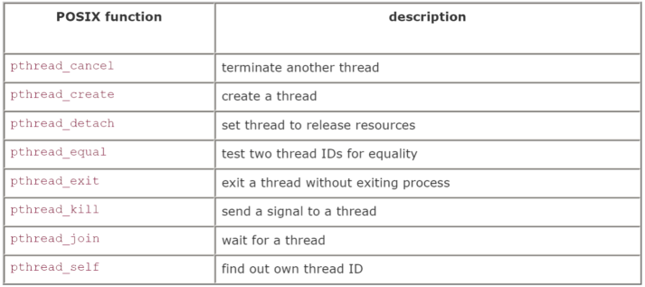
Pthread APIs
There is a whole set of library calls associated with threads, most of whose names start with pthread_.
To use these library calls, we must include the file pthread.h, and link with the pthread library using -pthread.
13

Slide 14
Pthread APIs
pthread_t
Build a pthread
#include<pthread.h>
pthread_t p;
14
Notes:
14

Slide 15
Pthread APIs
pthread_exit
If the main thread has no work to do after creating other threads, it should either block until all threads have completed or call pthread_exit().
#include<pthread.h>
pthread_t pthread_exit(void *value_ptr);
EX: pthread_exit(NULL); // if you don’t need return value
value_ptr:Point to the return value send to pthread_join
15
Notes:
15

Slide 16
Pthread APIs
pthread_join
Causes the caller to wait for the specified thread to exit.
#include<pthread.h>
pthread_t pthread_join(pthread_t thread, void **value_ptr);
EX: pthread_join(p ,NULL);
value_ptr: point to the value get from pthread_exit
16
Notes:
16

Slide 17
Outline
Producer-consumer problem
Semaphore
Application Programming Interface
Pthread API
Semaphore
Homework Assignment #2
Reference

Slide 18

Semaphore
There is a whole set of library calls associated with semaphore, most of whose names start with sem_t.
To use these library calls, we must include the file semaphore.h,
18

Slide 19
POSIX Semaphore APIs
We will use the following six functions
int sem_init()
Initialize a semaphore.
int sem_wait()
Decrease a sem’s value.
int sem_post()
Increase a sem’s value.
int sem_destroy()
Release the resource and destroy a semaphore.
int sem_getvalue()
Get a sem’s value.
19

Slide 20
POSIX Semaphore APIs
sem_init
Initializes a semaphore.
#include<semaphore.h>
int sem_init(sem_t *sem, int pshared,unsigned value);
Return -1 if unsuccessful
EX: sem_init(&sem , 1,1);
value:cannot be negative
pshared: A flag indicating whether or not the semaphore should be shared with forked processes.
-Pshared == 0 only threads of process creating semaphore can use semaphore.
Sem_t:the semaphore we initialize
20
Notes:
20

Slide 21
POSIX Semaphore APIs
sem_wait
Decrease the value.
int sem_wait ( sem_t *sem );
EX: sem_wait (&sem);
When the value become negative it will lock the process
21
Notes:
21

Slide 22
POSIX Semaphore APIs
sem_post
Increase the value.
int sem_post( sem_t *sem );
EX: sem_post(&sem);
When there are process lock by sem_wait, it will unlock it.
and it will increase the semaphore value.
22
Notes:
22

Slide 23
POSIX Semaphore APIs
sem_destroy
Destroys a previously declared semaphore.
int sem_destroy(sem_t *sem);
EX: sem_destroy (&sem );
Remember to destroy a semaphore when it is no longer needed.
23
Notes:
23

Slide 24
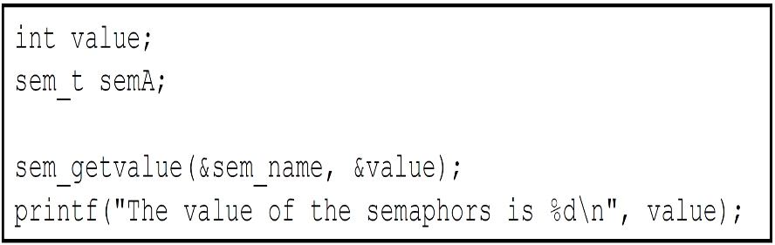
POSIX Semaphore APIs
sem_getvalue
Get the current value of sem and places the value in the location pointed to by val.
int sem_getvalue(sem_t *sem,int *val);
EX: sem_getvalue(&sem,&value);
24

Slide 25
Example
Binary semaphore: Integer value can range only between 0 and 1
Similar to mutex locks, used for mutex exclusion
Binary semaphore is initialized to 1
sem_init(&mutex,0,1);
Producer:
sem_wait(&empty);
sem_wait(&mutex); // entry critical section
count++;
sem_post(&mutex); // exit critical section
sem_post(&full);
Consumer:
sem_wait(&full);
sem_wait(&mutex);
count--;
sem_post(&mutex);
sem_post(&empty);
25

Slide 26
Example
Counting semaphore : Unrestricted integer value
Control access to a given resource with N instance
Semaphore value is initialized to N
sem_init(&empty,0,4);
sem_init(&full,0,0);
Producer:
sem_wait(&empty);
sem_wait(&mutex); // entry critical section
count++;
sem_post(&mutex); // exit critical section
sem_post(&full);
Consumer:
sem_wait(&full);
sem_wait(&mutex);
count--;
sem_post(&mutex);
sem_post(&empty);
26

Slide 27
Example
Counting semaphore : Unrestricted integer value
Control access to a given resource with N instance
Semaphore value is initialized to N
sem_init(&empty,0,4);
sem_init(&full,0,0);
Producer:
sem_wait(&empty);
sem_wait(&mutex); // entry critical section
count++;
sem_post(&mutex); // exit critical section
sem_post(&full);
Consumer:
sem_wait(&full);
sem_wait(&mutex);
count--;
sem_post(&mutex);
sem_post(&empty);
27

Slide 28
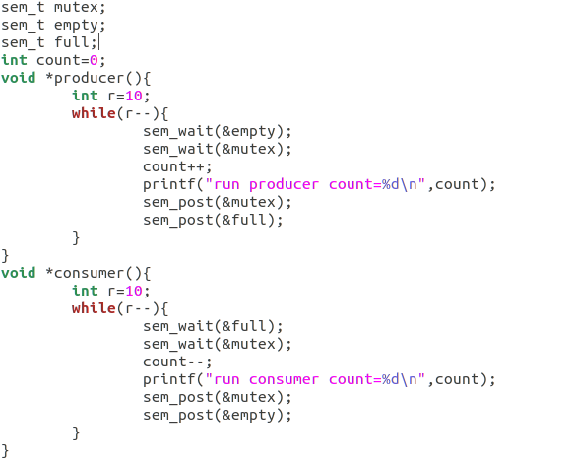
Example
Global value
28

Slide 29
Outline
Producer-consumer problem
Semaphore
Application Programming Interface
Homework Assignment #2
Reference

Slide 30
Homework Assignments #2
使用 Pthreads API 建立6個 threads : 4個 producers、2個 consumers
建立3個整數陣列:
a. 1個長度為1024，填入隨機亂數(使用rand)，以下稱為big buffer
b. 2個長度為 4，初始值為空，以下稱為 max - buffer 與 min-buffer
建立2個整數:
a. 第一個叫 maximum 初始值為 0
b. 第一個叫 minimum 初始值為 2147483647
30

Slide 31
Homework Assignments #2
每個producer會向 big buffer 取走固定位置的數字:
1號 producer 取走第 0~255 個數字
2號 producer 取走第 256~511 個數字
3號 producer 取走第 512~767 個數字
4號 producer 取走第 768~1023 個數字
當producer取走數字後，先計算出最大與最小值，再分別放入
max-buffer 與 min-buffer 裡
同時，consumers 也會向 max-buffer 與 min-buffer取走數字，再與maximum與minimum做比較，最終可得整個big buffer中最大與最小值
31

Slide 32
Homework Assignments #2
max
min
max
min
max
min
max
min
Big buffer with random number
長度為256的整數陣列
P
P
P
P
max
max
min
max_buffer
min_buffer
C
C
maximum
minimum
32

Slide 33
Homework Assignments #2
為了更好的追蹤你的程式，所以請在每一步驟印出相關訊息
當 producer 向 big buffer 取出256個數字並計算出最大值與最小值時:
Print : Producer: Temporary max={最大值} and min={最小值}
當 producer 將最大與最小值放入max-buffer 與 min-buffer 時:
Print : Producer: Put {最大值} into max-buffer at {當前的指向的位置}
以及 Producer: Put {最小值} into min-buffer at {當前的指向的位置}
當 consumer 從max-buffer 與 min-buffer 取出數字並更新maximum
與minimum時:
Print : Consumer: Updated! maximum= {最大值}
或是 Consumer: Updated! minimum= {最小值}
程式運算完成後，請印出:
Print : Success! maximum= {最大值} and minimum= {最小值}
33

Slide 34
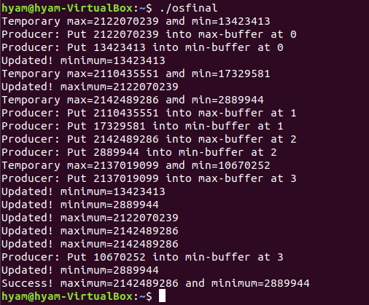
Result
34

Slide 35
Homework Assignments #2
Hint:
由於有max-buffer 與 min-buffer 2個 shared data，所以你應該要建立以
下semaphore :
max_buffer_full
min_buffer_full
max_buffer_mutex
min_buffer_mutex
由於producer生產的數量不會超過buffer size，所以不須建立empty semaphore
35

Slide 36
Outline
Producer-consumer problem
Semaphore
Application Programming Interface
Homework Assignment #2
Reference

Slide 37

Reference
Operating System Concepts, 10th Edition
Oslab: Lab12.ppt
Os: Ch6 Process Synchronization
37

Slide 38
Turn in
Upload to iLearning 3.0
File name
HW2_ID.zip (e.g. HW2_4110012345.zip)
Source code
.c file
Word
If you don’t hand in your homework on time, your score will be deducted 10 points every day.
38

Slide 39
TA
Name：Yung-Tung, Chou
Email：g110056158@mail.nchu.edu.tw
Title format : OS HW#2 - [your name]
Lab: OSNET(1001)
39

